Slide 1
Medical Imaging Course Final Assignment:
DICOM Images Coregistration
Refo Ilmiya Akbar
MUSI - Master Universitario en Sistemas Inteligentes

Slide 2
Outline
Introduction
Data Description
Implementation
Results
Conclusions

Slide 3
Introduction

Slide 4
Objective 1 of the project
Load, visualize, and perform coregistration of DICOM images
Focus on the HCC-TACE-Seg dataset of a certain assigned patient
Use PyDicom to load DICOM images and rearrange pixel arrays based on relevant headers
Create an animation showcasing a rotating Maximum Intensity Projection on the coronal-sagittal planes with segmentation shown
Notes:
The objective of this project is to perform semantic segmentation using VGG16UNet, a convolutional neural network architecture. The goal is to accurately classify and segment three different active classes in an image: Nucleus, Cytoplasm, and Environment. The output of the segmentation will be a grayscale image in unsigned integer 8 format, where the background is represented by black pixels, and the active classes are assigned equally spaced levels of gray. By leveraging the power of deep learning and semantic segmentation, this project aims to enable precise analysis and understanding of cellular structures, facilitating advanced research and analysis in various biological domains

Slide 5
Objective 2 of the project
Implement coregistration of images using landmarks or a custom similarity measure without external libraries using a brain CT-scan dataset
Visualize the Thalamus region in the input image space
Contribute to efficient loading, visualization, and coregistration of DICOM images for enhanced understanding and analysis of medical imaging data
Notes:
The objective of this project is to perform semantic segmentation using VGG16UNet, a convolutional neural network architecture. The goal is to accurately classify and segment three different active classes in an image: Nucleus, Cytoplasm, and Environment. The output of the segmentation will be a grayscale image in unsigned integer 8 format, where the background is represented by black pixels, and the active classes are assigned equally spaced levels of gray. By leveraging the power of deep learning and semantic segmentation, this project aims to enable precise analysis and understanding of cellular structures, facilitating advanced research and analysis in various biological domains

Slide 6
Data Description

Slide 7
The Dataset
Objective 1:
HCC-TACE-Seg is a dataset of hepatocellular carcinoma (HCC) cases.
It contains multimodality annotated cases with and without advanced imaging segmentation.
Objective 2:
Reference image: icbm avg 152 t1 tal nlin symmetric VI (a standardized template image of a brain)
Input image: RM Brain 3D-SPGR (3D spoiled gradient-recalled image)
Mask image: AAL3_1mm (Automated Anatomical Labelling atlas)
Notes:
Dataset Overview:
1000 lymphocyte images
500 images of normal lymphocytes
500 images of lymphocytes with Hairy Cell Leukemia (HCL)
Active Classes:
Nucleus:
Represents the cell's central genetic material
Key component for cellular control and function
Cytoplasm:
Encompasses the entire cell except the nucleus
Contains organelles and structures supporting cell functions
Environment:
Area surrounding the lymphocyte
Provides insights into cell-cell and cell-environment interactions

Slide 8
Implementation

Slide 9
Objective 1: The Implementation
Downloading and Visualization
Data analysis
Loading and Examining DCM files
Segmented Image Creation
Generating GIF file
- Download the assigned HCC 001 dataset using NBIA Data Retriever.
- Visualize the dataset using 3D Slicer to gain a better understanding of the data.
- Identify the specific acquisition for valid segmentation data.
- Determine the four segmentation sequences: liver, tumor, vessels, and aorta.
- Load the DCM files corresponding to the second acquisition along with their segmentation data.
[More on the next slide]
- Perform alpha-fusion iteratively along the first axis using an alpha value of 0.2 for the mask and 0.8 for the image to create segmented images.
[More on the next slide]
- Apply axial rotation to the segmented image.
Use 48 projections with a 30-degree interval for rotation.
[More on the next slide]
Notes:
Segmentation Dataset Class:
Purpose: Custom dataset for semantic segmentation.
Inputs: Image paths, mask paths, transformations, and number of classes.
__len__ function:
Returns the total number of samples in the dataset.
__getitem__ function:
Retrieves image and mask at given index.
Loads image and mask using PIL.
Applies Albumentations transforms.
Converts flat mask to deep mask.
__deep_mask__ function:
Converts grayscale mask to channeled grayscale mask.
Applies mask thresholds using NumPy operations.
Returns image and mask tensors.

Slide 10
Loading and Examining DCM files
Load the three-dimensional array of the DCM files.
Examine the information from the segmentation dataset's DCM files to identify the corresponding slices in the array for each segment.
Flip the segmented image on the second axis for correct orientation.
Analyze the array indices to identify the tumor slices (range: 37-73).
Notes:
Dataset Overview:
1000 lymphocyte images
500 images of normal lymphocytes
500 images of lymphocytes with Hairy Cell Leukemia (HCL)
Active Classes:
Nucleus:
Represents the cell's central genetic material
Key component for cellular control and function
Cytoplasm:
Encompasses the entire cell except the nucleus
Contains organelles and structures supporting cell functions
Environment:
Area surrounding the lymphocyte
Provides insights into cell-cell and cell-environment interactions

Slide 11
Segmented Image Creation
Perform alpha-fusion iteratively along the first axis using an alpha value of 0.2 for the mask and 0.8 for the image to create segmented images.
Visualize the segmented images by plotting both the image and segmented image.
Apply alpha value of 0.8 to the image for overlay effect on the CT scan.
Conduct multiple visualizations using Median, Maximum Intensity Projection (MIP), and Average Intensity Projection (AIP) across the sagittal and coronal planes
Notes:
Dataset Overview:
1000 lymphocyte images
500 images of normal lymphocytes
500 images of lymphocytes with Hairy Cell Leukemia (HCL)
Active Classes:
Nucleus:
Represents the cell's central genetic material
Key component for cellular control and function
Cytoplasm:
Encompasses the entire cell except the nucleus
Contains organelles and structures supporting cell functions
Environment:
Area surrounding the lymphocyte
Provides insights into cell-cell and cell-environment interactions

Slide 12
Generating GIF file
Apply axial rotation to the segmented image.
Use 48 projections with a 30-degree interval for rotation.
For each projection, rotate the image and segmented image by a certain degree and plot the MIP sagittal plane.
Implement a loop over the projections and combine the resulting frames using ArtistAnimation.
Generate a GIF file.
Notes:
Dataset Overview:
1000 lymphocyte images
500 images of normal lymphocytes
500 images of lymphocytes with Hairy Cell Leukemia (HCL)
Active Classes:
Nucleus:
Represents the cell's central genetic material
Key component for cellular control and function
Cytoplasm:
Encompasses the entire cell except the nucleus
Contains organelles and structures supporting cell functions
Environment:
Area surrounding the lymphocyte
Provides insights into cell-cell and cell-environment interactions

Slide 13
Objective 2: The Implementation
Loading and Pixel Array Extraction
Visualizations and Preprocessing
Coregistration
Thalamus Region Masking
- Load the three images:
- reference image
- input image
- segmentation image
- Conduct horizontal, sagittal, and coronal visualizations to assess the effects of preprocessing
[More on the next slide]
- Implement the coregister landmarks() function to coregister the images through a rigid transformation using landmark points.
[More on the next slide]
- Implement the 'getthalamusmask()' function to generate a mask by selecting the thalamus indexes.
[More on the next slide]
Notes:
Dataset Overview:
1000 lymphocyte images
500 images of normal lymphocytes
500 images of lymphocytes with Hairy Cell Leukemia (HCL)
Active Classes:
Nucleus:
Represents the cell's central genetic material
Key component for cellular control and function
Cytoplasm:
Encompasses the entire cell except the nucleus
Contains organelles and structures supporting cell functions
Environment:
Area surrounding the lymphocyte
Provides insights into cell-cell and cell-environment interactions

Slide 14
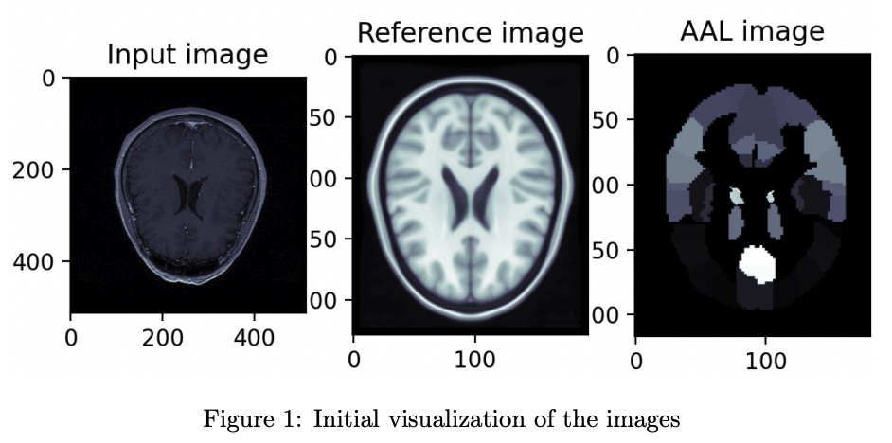
Visualizations and preprocesing
Notes:
Dataset Overview:
1000 lymphocyte images
500 images of normal lymphocytes
500 images of lymphocytes with Hairy Cell Leukemia (HCL)
Active Classes:
Nucleus:
Represents the cell's central genetic material
Key component for cellular control and function
Cytoplasm:
Encompasses the entire cell except the nucleus
Contains organelles and structures supporting cell functions
Environment:
Area surrounding the lymphocyte
Provides insights into cell-cell and cell-environment interactions

Slide 15
Visualizations and preprocesing
Preprocess the images to address differences:
Crop the reference image and segmentation image to match the size of (181, 216, 181).
Transform the input image through cropping, zooming, rotation, and intensity normalization to align it with the other images and achieve consistent intensity levels.
Normalize the input image to have a similar range of values as the reference image.
Notes:
Dataset Overview:
1000 lymphocyte images
500 images of normal lymphocytes
500 images of lymphocytes with Hairy Cell Leukemia (HCL)
Active Classes:
Nucleus:
Represents the cell's central genetic material
Key component for cellular control and function
Cytoplasm:
Encompasses the entire cell except the nucleus
Contains organelles and structures supporting cell functions
Environment:
Area surrounding the lymphocyte
Provides insights into cell-cell and cell-environment interactions

Slide 16
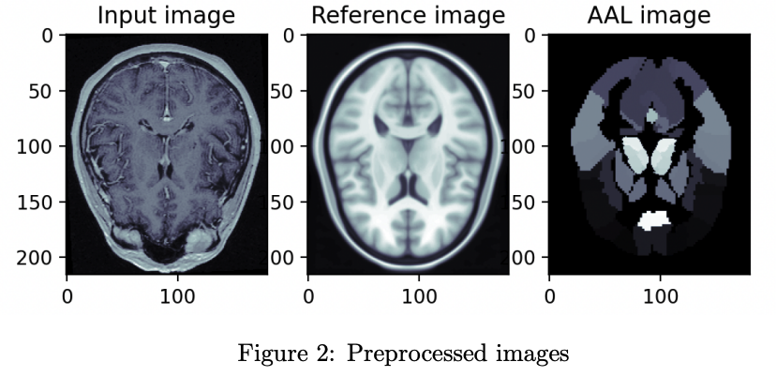
Visualizations and preprocesing
Notes:
Dataset Overview:
1000 lymphocyte images
500 images of normal lymphocytes
500 images of lymphocytes with Hairy Cell Leukemia (HCL)
Active Classes:
Nucleus:
Represents the cell's central genetic material
Key component for cellular control and function
Cytoplasm:
Encompasses the entire cell except the nucleus
Contains organelles and structures supporting cell functions
Environment:
Area surrounding the lymphocyte
Provides insights into cell-cell and cell-environment interactions

Slide 17
Coregistration
Transform the reference and input images into 3-dimensional arrays using the reshape(-1,3) function
Examine the residual vector between each point to observe disparities
Perform a 3D visualization on each point of the 3D arrays for comparison
Implement the coregister landmarks() function to coregister the images through a rigid transformation using landmark points
Update initial parameters, compute centroids, and define a function to minimize residuals
Optimize the transformation parameters using the least squares function to minimize residuals
Notes:
Segmentation Dataset Class:
Purpose: Custom dataset for semantic segmentation.
Inputs: Image paths, mask paths, transformations, and number of classes.
__len__ function:
Returns the total number of samples in the dataset.
__getitem__ function:
Retrieves image and mask at given index.
Loads image and mask using PIL.
Applies Albumentations transforms.
Converts flat mask to deep mask.
__deep_mask__ function:
Converts grayscale mask to channeled grayscale mask.
Applies mask thresholds using NumPy operations.
Returns image and mask tensors.

Slide 18
Coregistration
Create downsampled arrays of the input and reference images to reduce computation time
Perform coregistration between the downscaled arrays to obtain optimal coregistration parameters
Adjust the input image with the reference image using the translation then axialrotation() function
Visualize the effects of the coregistration process (next slide)
Notes:
Segmentation Dataset Class:
Purpose: Custom dataset for semantic segmentation.
Inputs: Image paths, mask paths, transformations, and number of classes.
__len__ function:
Returns the total number of samples in the dataset.
__getitem__ function:
Retrieves image and mask at given index.
Loads image and mask using PIL.
Applies Albumentations transforms.
Converts flat mask to deep mask.
__deep_mask__ function:
Converts grayscale mask to channeled grayscale mask.
Applies mask thresholds using NumPy operations.
Returns image and mask tensors.

Slide 19
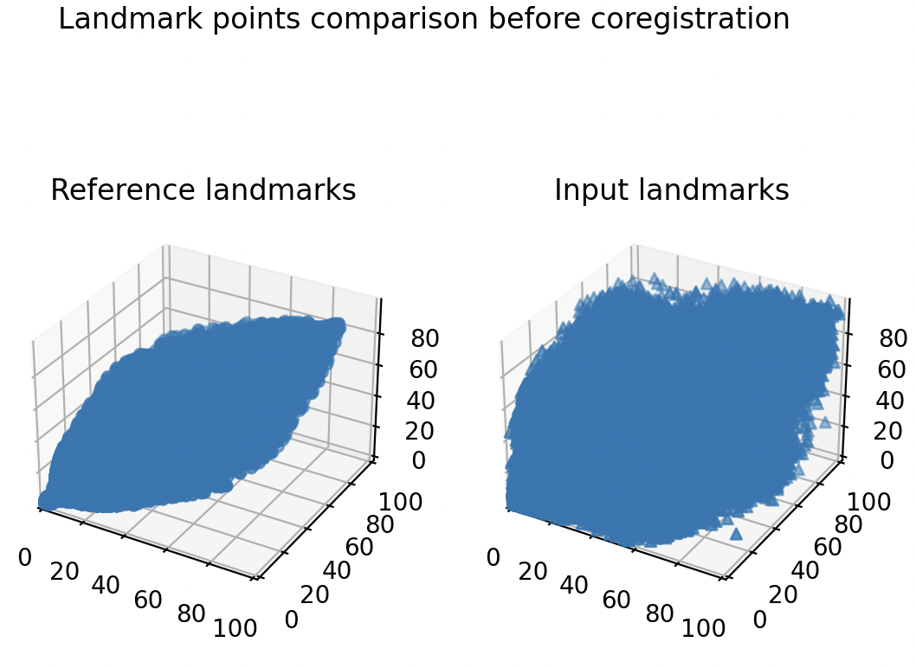
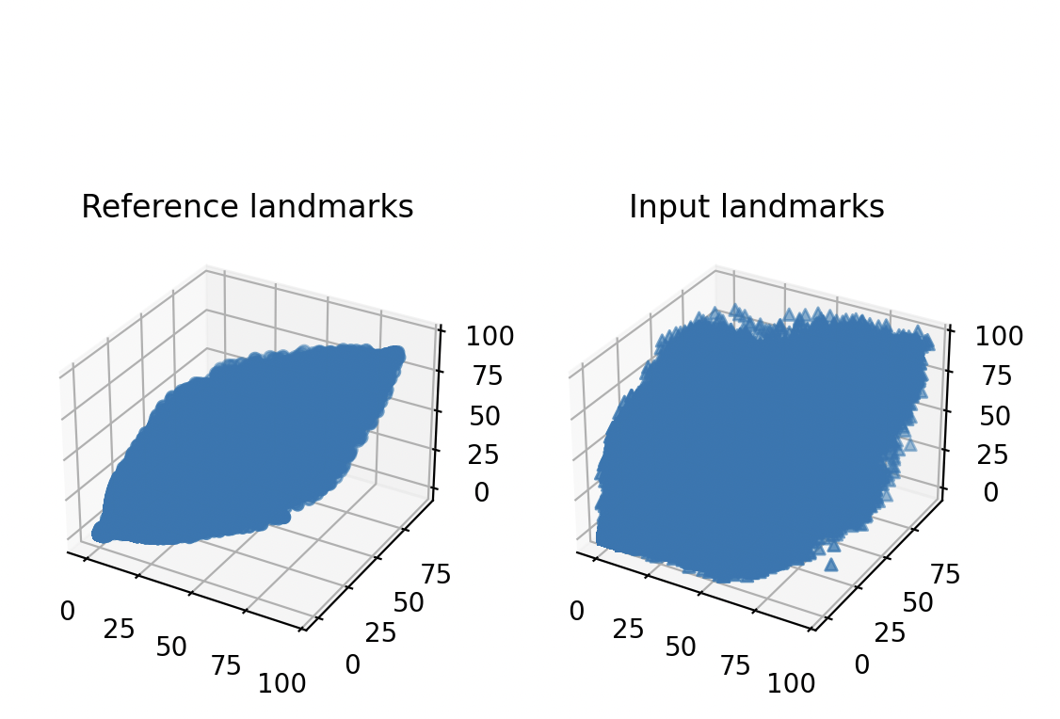
Coregistration (Visualizations)
Landmark points comparison after coregistration
Notes:
Segmentation Dataset Class:
Purpose: Custom dataset for semantic segmentation.
Inputs: Image paths, mask paths, transformations, and number of classes.
__len__ function:
Returns the total number of samples in the dataset.
__getitem__ function:
Retrieves image and mask at given index.
Loads image and mask using PIL.
Applies Albumentations transforms.
Converts flat mask to deep mask.
__deep_mask__ function:
Converts grayscale mask to channeled grayscale mask.
Applies mask thresholds using NumPy operations.
Returns image and mask tensors.

Slide 20
Thalamus Region Masking
Implement the 'getthalamusmask()' function to generate a mask by selecting the thalamus indexes.
Utilize the 'visualaxialslice()' function to perform alpha fusion between the thalamus region mask and the input image.
Apply the same fusion to the reference image for verification.
Notes:
Segmentation Dataset Class:
Purpose: Custom dataset for semantic segmentation.
Inputs: Image paths, mask paths, transformations, and number of classes.
__len__ function:
Returns the total number of samples in the dataset.
__getitem__ function:
Retrieves image and mask at given index.
Loads image and mask using PIL.
Applies Albumentations transforms.
Converts flat mask to deep mask.
__deep_mask__ function:
Converts grayscale mask to channeled grayscale mask.
Applies mask thresholds using NumPy operations.
Returns image and mask tensors.

Slide 21
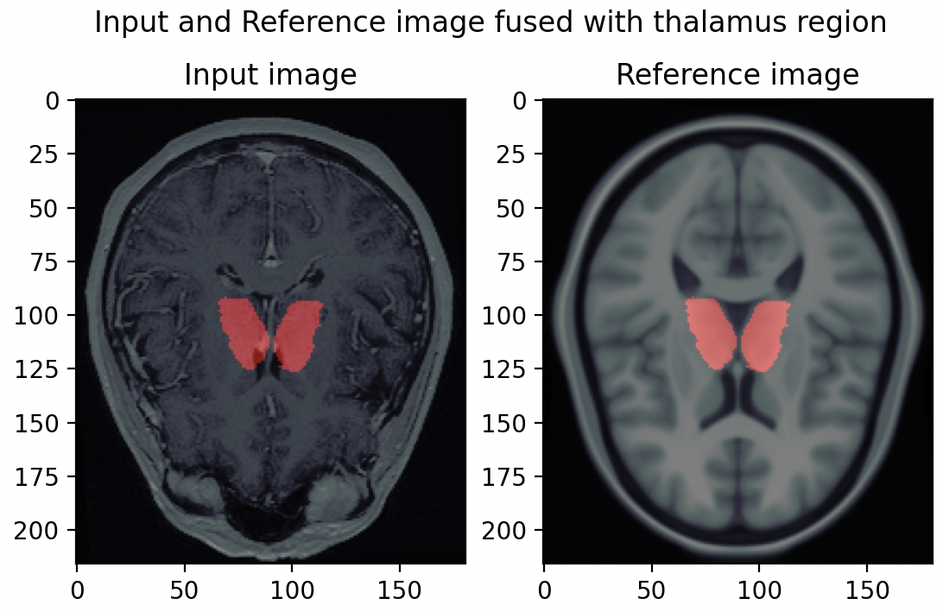
Thalamus Region Masking (Visualization)
Notes:
Segmentation Dataset Class:
Purpose: Custom dataset for semantic segmentation.
Inputs: Image paths, mask paths, transformations, and number of classes.
__len__ function:
Returns the total number of samples in the dataset.
__getitem__ function:
Retrieves image and mask at given index.
Loads image and mask using PIL.
Applies Albumentations transforms.
Converts flat mask to deep mask.
__deep_mask__ function:
Converts grayscale mask to channeled grayscale mask.
Applies mask thresholds using NumPy operations.
Returns image and mask tensors.

Slide 22
Thalamus Region Masking
Perform a reverse transformation to observe the masking in the input space.
Slice the fused image to obtain a 2-dimensional array and match its intensity with the original image intensity after coregistration.
Repeat the coregistration process with inverted values of the best parameters.
Repeat the preprocessing steps with inverted values, including rotation, resizing, and zooming out, and add padding to restore the original size.
Generate a visualization of the mask in the input space.
Notes:
Segmentation Dataset Class:
Purpose: Custom dataset for semantic segmentation.
Inputs: Image paths, mask paths, transformations, and number of classes.
__len__ function:
Returns the total number of samples in the dataset.
__getitem__ function:
Retrieves image and mask at given index.
Loads image and mask using PIL.
Applies Albumentations transforms.
Converts flat mask to deep mask.
__deep_mask__ function:
Converts grayscale mask to channeled grayscale mask.
Applies mask thresholds using NumPy operations.
Returns image and mask tensors.

Slide 23
Results

Slide 24
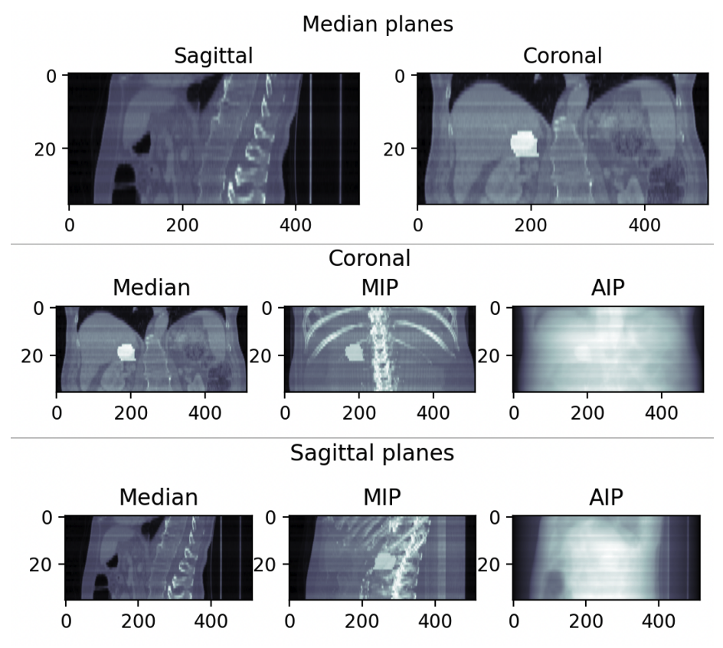
Objective 1 results
Notes:
Time: 595s
Accuracy: Dice coefficient: 96.11%

Slide 25
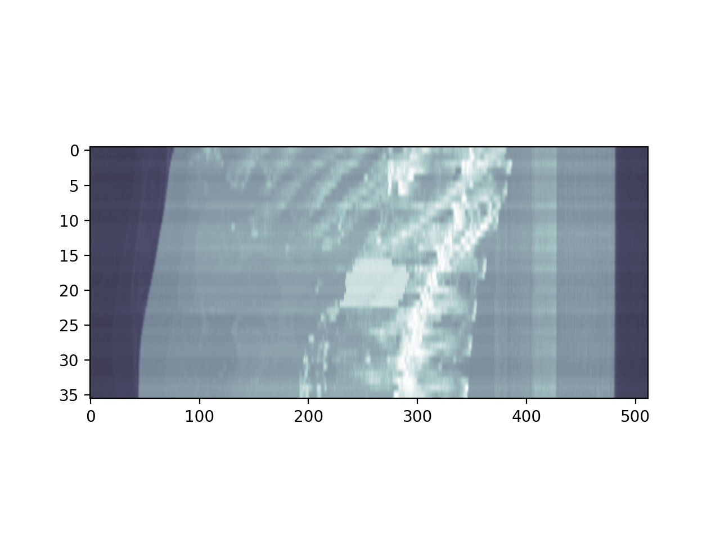
Objective 1 results
48 projections of sagittal-coronal planes with 30ms interval
Notes:
Time: 595s
Accuracy: Dice coefficient: 96.11%

Slide 26
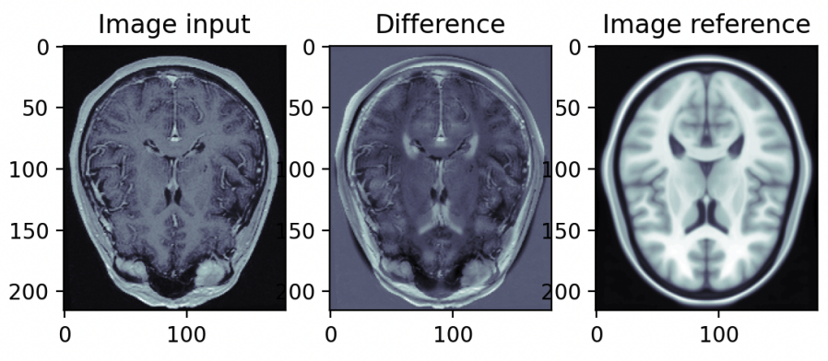
Objective 2 results
Notes:
Time: 595s
Accuracy: Dice coefficient: 96.11%

Slide 27
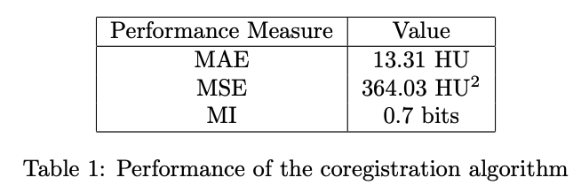
Objective 2 results
Notes:
Time: 595s
Accuracy: Dice coefficient: 96.11%

Slide 28
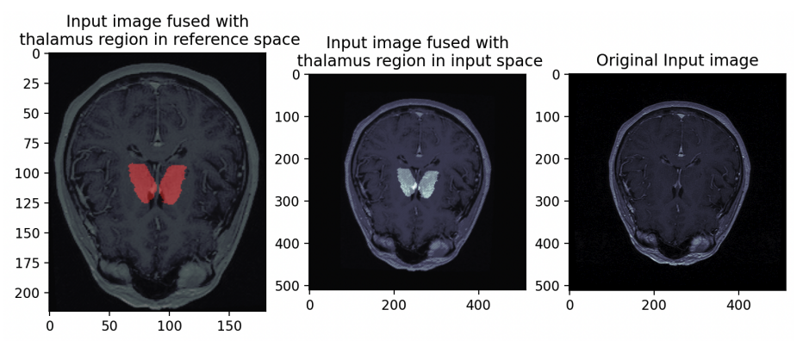
Objective 2 results
Notes:
Time: 595s
Accuracy: Dice coefficient: 96.11%

Slide 29
Conclusions

Slide 30
Highlights of the Project
Valuable insights: Gained insights into the complexities associated with working with DICOM data
Contribution to technical skills: Enhanced technical skills in medical imaging techniques
Challenges: Understanding DCM files, long computation time for coregistration, and initially unclear project objectives
Overcame challenges: Through persistent efforts and learning from previous lab activities
The project was enjoyable and engaging

Slide 31
Source code:
https://github.com/realr3fo/medical_imaging

Slide 32
Bibliography
https://wiki.cancerimagingarchive.net/pages/viewpage.action?pageId=70230229
https://pydicom.github.io/pydicom/stable/auto examples/index.html
https://mscipio.github.io/post/read dicom files in python/

